Slide 1
Design and Implementation of Low cost Blood Group Detection using Image Processing

Slide 2
OBJECTIVE
In this project, proposing approaches for blood Group measurement with the aim of recommending data collection techniques, signal extraction processes, feature calculation processes, Image Processing algorithms for developing a noninvasive Blood Group estimation using a Image.

Slide 3
Abstract
There is worldwide demand for an affordable Blood Group measurement solution, which is a particularly urgent need in developing countries.
The Image Processing, which is the most penetrated device in both rich and resource-constrained areas, would be a suitable choice to build this solution.
This Project proposes a noninvasive Blood Group measurement processes. Also its compared the variation in data collection sites, biosignal processing techniques, theoretical foundations, photoplethysmogram (PPG) signal and features extraction process, Image Processing algorithms, and Detection models to calculate Blood Groups.
This analysis was then used to recommend realistic approaches to build a Image Processing-based point-of-care tool for Blood Group measurement in a noninvasive manner

Slide 4
INTRODUCTION
Blood Group abnormalities cause several blood diseases, and lead to fatal and chronic health problems, including heart attack, stroke, and pregnancy complications.
When an adequate blood is not maintained, the disorder complicates the function of the major organs (eg, kidney, brain, and heart) that require oxygen.
Thus, an disorder diagnosis based on an invasive method is not a perfect solution, especially for people in low- and middle-income countries .

Slide 5
Existing System
Blood Group level measurement is a blood diagnosis process to determine the concentration of cell count in the blood. Clinicians measure Blood Group in several ways.
Although the invasive (blood sample collection) approach remains the most common.
Invasive processes involve the addition of various chemicals to a blood sample and then optical variations are calculated using spectroscopic data to measure the Blood Group level.

Slide 6
Disadvantages
(1) challenging data collection methods
(2) complex data analysis and feature extraction processes
(3) lack of affordability and portability
(4) lack of user-friendliness with costly external modules.

Slide 7
Proposed System
A noninvasive (without blood sample collection) approach involves data obtained from image sensors, spectroscopic information, and output of a photoplethysmographic (PPG) sensor to calculate the Blood Group level.
A Image Processing-based POC tool as a potential alternative to invasive clinical blood testing is rapidly attracting attention because of the advantages of availability, user-friendliness, and easy attachability to different biosensing devices.

Slide 8
Proposed System
The fingertip area is one of the best data collection sites from the body, followed by the lower eye conjunctival area.
Near-infrared (NIR) light-emitting diode (LED) light were identified as potential light sources to receive a Blood Group response from living tissue.
PPG signals from fingertip videos, captured under various light sources, can provide critical physiological clues.
The features of PPG signals captured under NIR LED are considered to be the best signal combinations following a dual-wavelength theoretical foundation.

Slide 9
Proposed System
The PPG signal is generated from each video, and multiple characteristic features are then extracted from the PPG signal, its derivatives and from Frequency analysis.
genetic algorithms (GA) has been used to select the optimal features (Feature selection).
Finally, CNN based models have been developed to estimate the blood Blood Group (Blood Group) levels from the selected features.
The approach expected to provides the best-estimated accuracy of aound 98%.

Slide 10
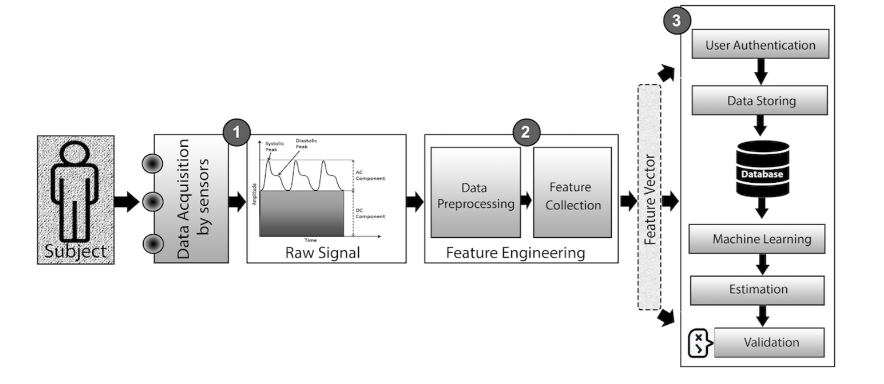
PROPOSED BLOCK DIAGRAM

Slide 11
MODULES

Slide 12
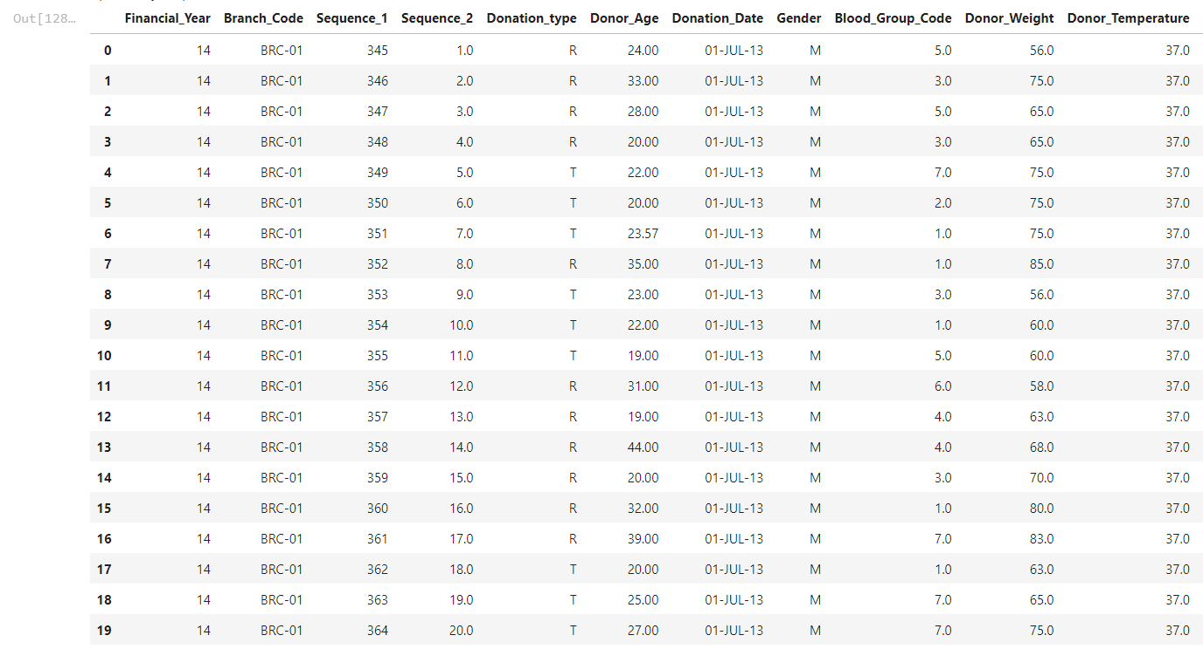
DATASET COLLECTION Module

Slide 13
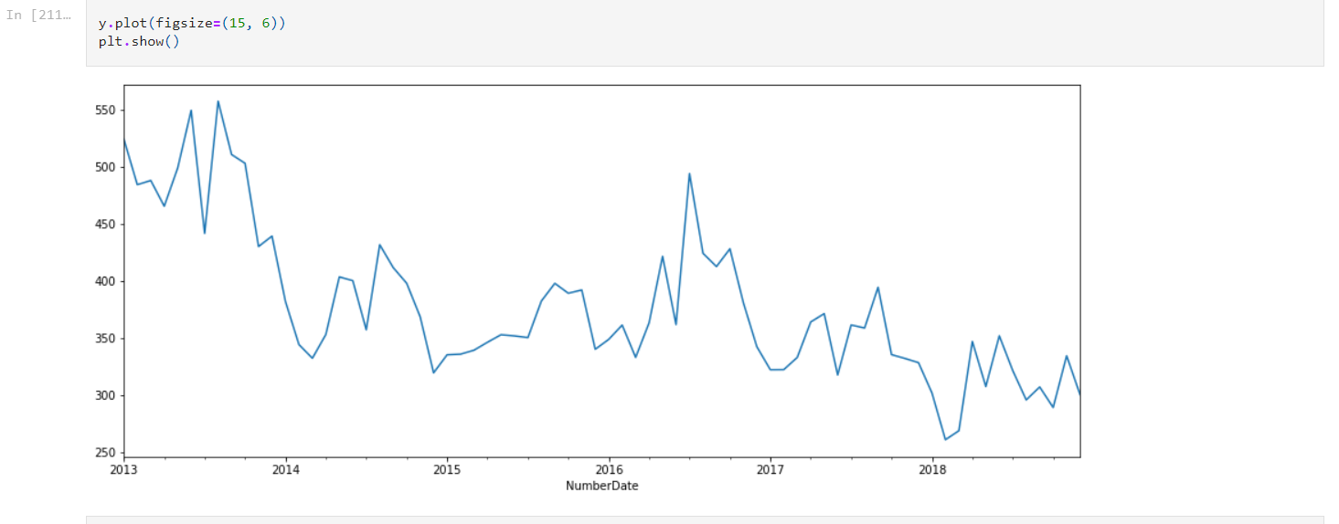
PREPROCESSING MODULE

Slide 14
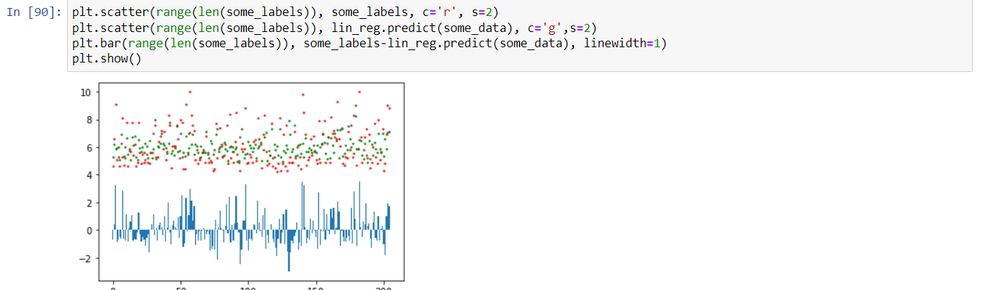
CELLS EXTRACTION

Slide 15
Functional Module
Describe functionality or system services.
Depend on the type of software, expected users and the type of system where the software is used.
Functional user requirements may be high-level statements of what the system should do but functional system requirements should describe the system services in detail.

Slide 16
FunctionalModule
The user shall be able to search either all of the initial set of databases or select a subset from it.
The system shall provide appropriate viewers for the user to read NIR Spectroscopy Images in the Database to store.
Every Sample shall be allocated a unique Blood Group which the user shall be able to test to the systems Trained area.

Slide 17
TYESTING MODULE
Product requirement
The user interface for Blood Grouping detection shall be implemented as HTML with frames or Java applets and Logics can be performed using python.
External requirement
The system shall not disclose any personal information about Users apart from their name and reference number to the operators of the system.

Slide 18
TESTING MODULE
These define system properties and constraints e.g. reliability, response time and storage requirements. Constraints are I/O device capability, system representations, etc.
Process requirements may also be specified mandating a particular CASE system, programming language or development method.
Non-functional requirements may be more critical than functional requirements. If these are not met, the system is useless.

Slide 19
SOFTWARE REQUIREMENT
HARDWARE SPECIFICATION
Processor : Any Processor above 500 MHz
Ram : 4 GB
Hard Disk : 500 GB.
Input device : Standard Keyboard and Mouse.
Output device : VGA and High Resolution Monitor.
SOFTWARE SPECIFICATION
Operating System : Windows Family.
Programming Language : Python, Matlab C
IDE : Matlab or Python

Slide 20
References
1. Ataga KI, Gordeuk VR, Agodoa I, Colby JA, Gittings K, Allen IE. Low Blood Group increases risk for cerebrovascular disease, kidney disease, pulmonary vasculopathy, and mortality in sickle cell disease: A systematic literature review and meta-analysis. PLoS One 2020 Apr 3;15
(4):e0229959 [FREE Full text] [doi: 10.1371/journal.pone.0229959] [Medline: 32243480]
2. van Swelm RPL, Wetzels JFM, Swinkels DW. The multifaceted role of iron in renal health and disease. Nat Rev Nephrol 2020 Feb 25;16(2):77-98. [doi: 10.1038/s41581-019-0197-5] [Medline: 31554933]
3. Mann D, Riddell L, Lim K, Byrne LK, Nowson C, Rigo M, et al. Mobile phone app aimed at improving iron intake and bioavailability in premenopausal women: a qualitative evaluation. JMIR Mhealth Uhealth 2015 Sep 28;
3(3):e92 [FREE Full text] [doi: 10.2196/mhealth.4300] [Medline: 26416479]
4. Kulandaivelu Y, Lalloo C, Ward R, Zempsky WT, Kirby-Allen M, Breakey VR, et al. Exploring the needs of adolescents with sickle cell disease to inform a digital self-management and transitional care program: qualitative study. JMIR Pediatr Parent 2018 Sep 25;1(2):e11058 [FREE Full text] [doi: 10.2196/11058] [Medline: 31518307]
5. Le CHH. The prevalence of anemia and moderate-severe anemia in the US population (NHANES 2003-2012). PLoS One 2016 Nov 15;11(11):e0166635 [FREE Full text] [doi: 10.1371/journal.pone.0166635] [Medline: 27846276]
6. Krishnamurti L, Ross D, Sinha C, Leong T, Bakshi N, Mittal N, et al. Comparative effectiveness of a web-based patient decision aid for therapeutic options for sickle cell disease: randomized controlled trial. J Med Internet Res 2019 Dec 04;21(12):e14462 [FREE Full text] [doi: 10.2196/14462] [Medline: 31799940]

